Slide 1
Insurance Claim settlement
Team

Slide 2
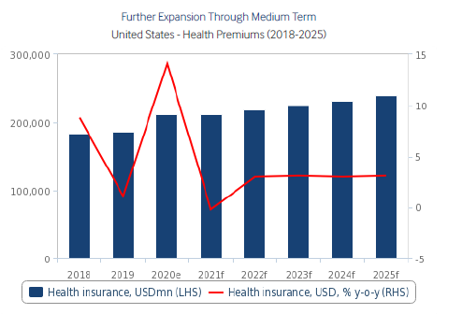


US Health-care Insurance market
Health insurance in USA
91.4
91.4% of percentage people have health insurance coverage
66.5
66.5% are covered by private insurance
54
54% of private insurance are employment-based
US national healthcare expenditure is $3.18 trillion and estimated to reach $6.2 trillion by 2028.
US healthcare sector market size is 1.1 trillion with expected growth of 6.6%
Health care coverage is segmented upon diseases, age of the claimant , distribution channel, medical/diseases etc.

Slide 3





Insurance company process : Premium & Process of claim
Premium pricing
Insurance company
Collection of Customer data
Determine internal or external pricing mechanism
Depending upon health insurance policy-Segregate
Estimate and predict for next few years
Check against competitors and fix premium
Claim settlement
Claim application for settlement
(UB04 and CMS1500)
Claims adjudication
(checking of the sanctity of claim)
Claims validation, justification and Price settlement
Explanation of benefits (notification and informing details)
Claim settlement (either individually or in bulk)
Claimants
Mr. Smith | Age:34
Working in construction industry. Buys personal insurance as he does not get employee benefits
XXX | Hospital
Network hospital with more than 1000 claims per month
XXX | Hospital
Out of network hospital with maximum of 5 claims per year

Slide 4
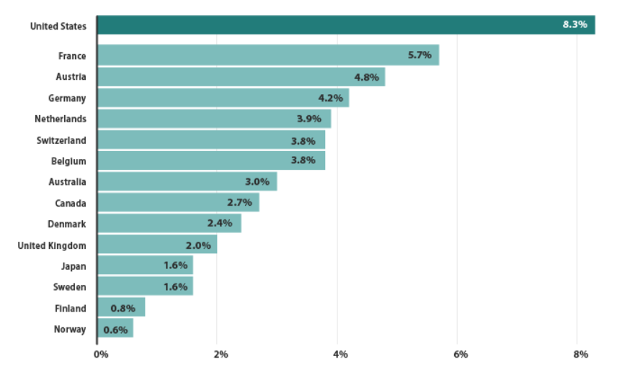
Understanding of problem statement
Claim Request
Intial process review
Automatic Review
Problem statement
Claims Adjudication
External pricing
If the claim does not meet the criteria, the insurance company uses Third party authorizers for pricing
Preliminary checks
Check whether the details filled in claim are accurate
Claim request
The claim request can be from individuals, network hospitals or out of network hospitals
Automatic review
Check whether the client has current coverage, duplicate claim settlements, diagnosis error etc.
Payment determination
Depending upon the upstream process, the claim is divided into three- paid, denied and reduced
Internal pricing
If the claim meets certain criteria, the insurance company takes up the review and pricing
$1.3 billion healthcare claims are made per year.
Administration costs are the highest in USA market due to decentralized system

Slide 5


Our Approach
Process of Insurance claim, Industry trends, Diffrent stakeholders inviolved
We started with Secondary research
Diffrent sources include CHS, Statistics, recent research papers about using AI/ML in Insurance industryetc
Secondary Market Research
Differnt Painponts faced by the users and Insurance agents in getting claiming and receiveing the claim
Interviwed Industry experts and Isurance agents
Claim Forms form diffrent insurance instiutes, Prcesses, Pain points of diffrent stake oleders, Diffrent types of Insurances etc
Primary Research

Slide 6
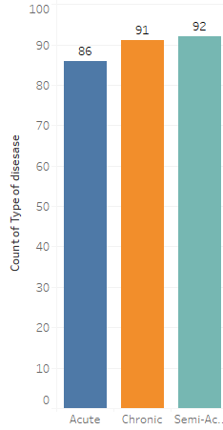
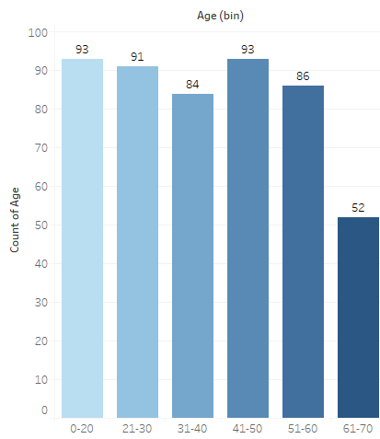
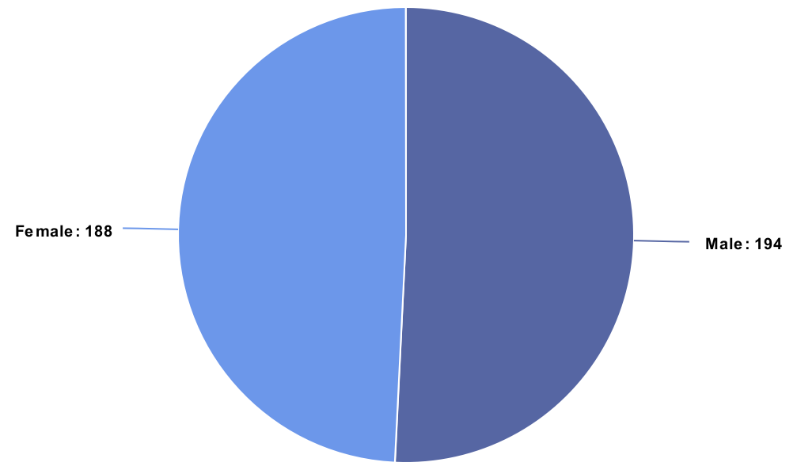
Exploratory Data Analysis (1/2)
Gender Distribution
Types of Diseases
Age Distribution
Data is fairly distributed among diffrent age groups from having an average of 47 years
Among the 500 data points collected we have 50:50 ration between the number of Males and Females
We have divided the diseases into three catagories:
Acute, Semi-Acute & Chronic

Slide 7
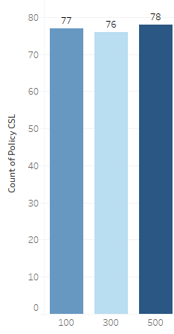
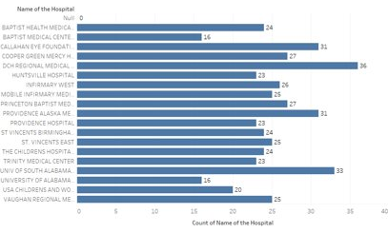
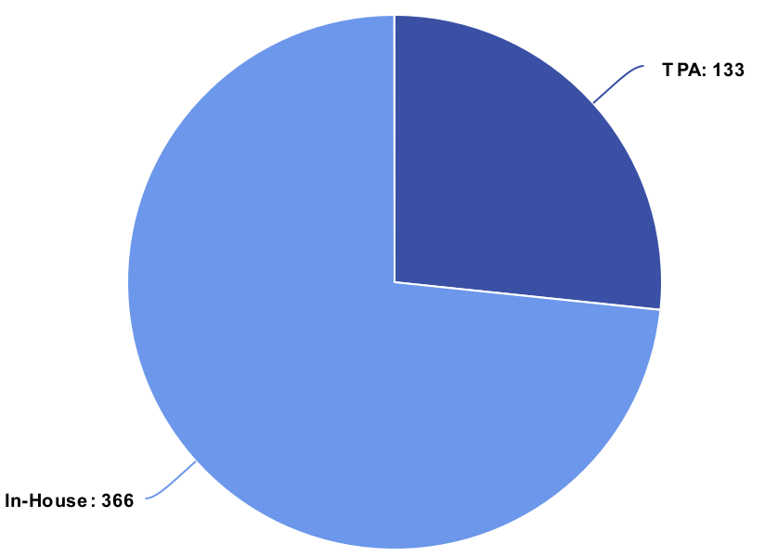
Exploratory Data analysis (2/2)
Distribution among Hospitals
Policy CSL Distribution
TPA/ Non - TPA
Out of 500 users 2/3 of the aclims are settled through Third Party Administrator
The 500 data points are fairly distributed among 20 hospitals
Three types of Combined Single Limits are identified in the Policys for accidents

Slide 8
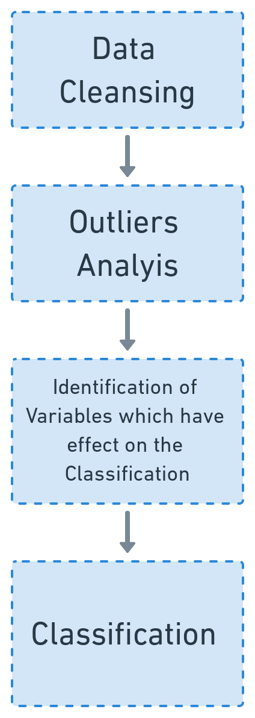
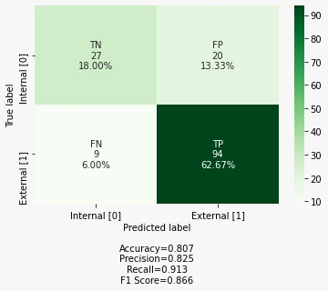
Algorithm - Classification
Steps Followed
Important Features/ Algorthim Comparision
Confusion Matrix(LR)
1)"Does the Insurer have internal claim process"
2)"Is the hospital partnered with the Insurance company
Model | Accuracy
Logistic Regression | 0.807
Decision tree | 0.78
Naïve Bayers | 0.533
Random Forest | 0.74

Slide 9
Algorithm - Pricing

Slide 10






AI/ML in Insurance sector– Way forward
Steps where AI/ML can further be used
Fraud detection
Verify the claim details and detect fraud before claim settlement
In 2019, $2.6 billion is recovered from health care fraud.
Use AI-based chat bots to reduce the costs
According to Juniper Study, using AI chatbots for insurance increase cost saving by $1.3 billion by 2023
Interactive Chatbots
Premium can be estimated based on fitness tracking system and can be personalized
AI/ML models work better than the generalized linear models for premium prediction and pricing
Premium pricing
Customer preferences prediction
Use AI/ML to gain insight into customer preferences and provide incentives to remain healthy
AI/ML models are tending towards “pay as you live“ models where premium is priced as per the customer lifestyle
Use predictive analysis to generate personalized offerings and products. Increase the CLV for profits
Better customer retention thereby reducing costs for the insurance administration costs
Marketing of insurance
Implementation of Claim triage to process urgent claim settlements faster
Claim processing

Slide 11

Appendices
12

Slide 13
Thank You
14

